Slide 1
I GYM Project Presentation
Group E
Mohamed Amgad
Marwan Lotfy
Alhussien Ali
Khaled Waleed
ICT HUB
Web Development
July 2024

Slide 2
Introduction
In today's digital age, effective management tools are crucial for the success of any business especially in the fitness industry, we developed using HTML and CSS a website for a gym management system called I GYM which is an app for desktop and mobile phones, the website aims to revolutionize how gyms operate, offering seamless management solutions tailored to enhance efficiency, member experience, and administrative ease.

Slide 3
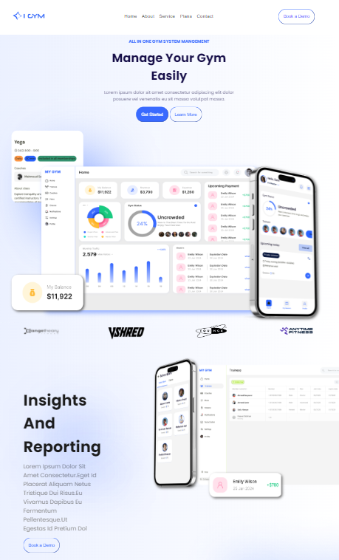
Section 1 Marwan Lotfy
This section consists of :-
The Website Logo.
Navigation Bar
3 buttons
Screenshots of the app interface in desktop and mobile

Slide 4
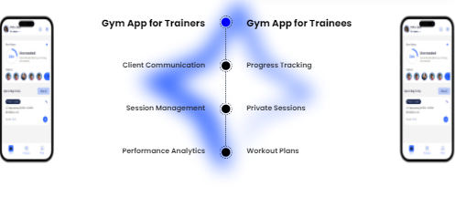
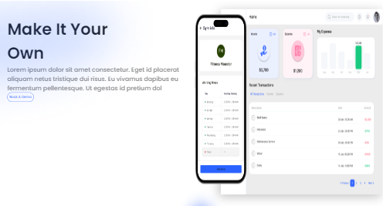
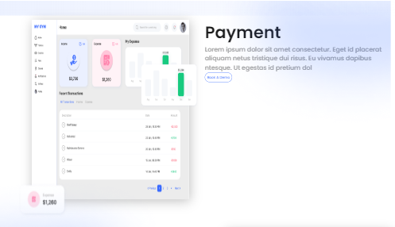
Section 2 Mohamed Amgad
This section consists of :-
Desktop and mobile screenshots of the app payment interface including transactions.
Mobile app screenshots of Trainers and Trainees interfaces which help both in their needs.

Slide 5
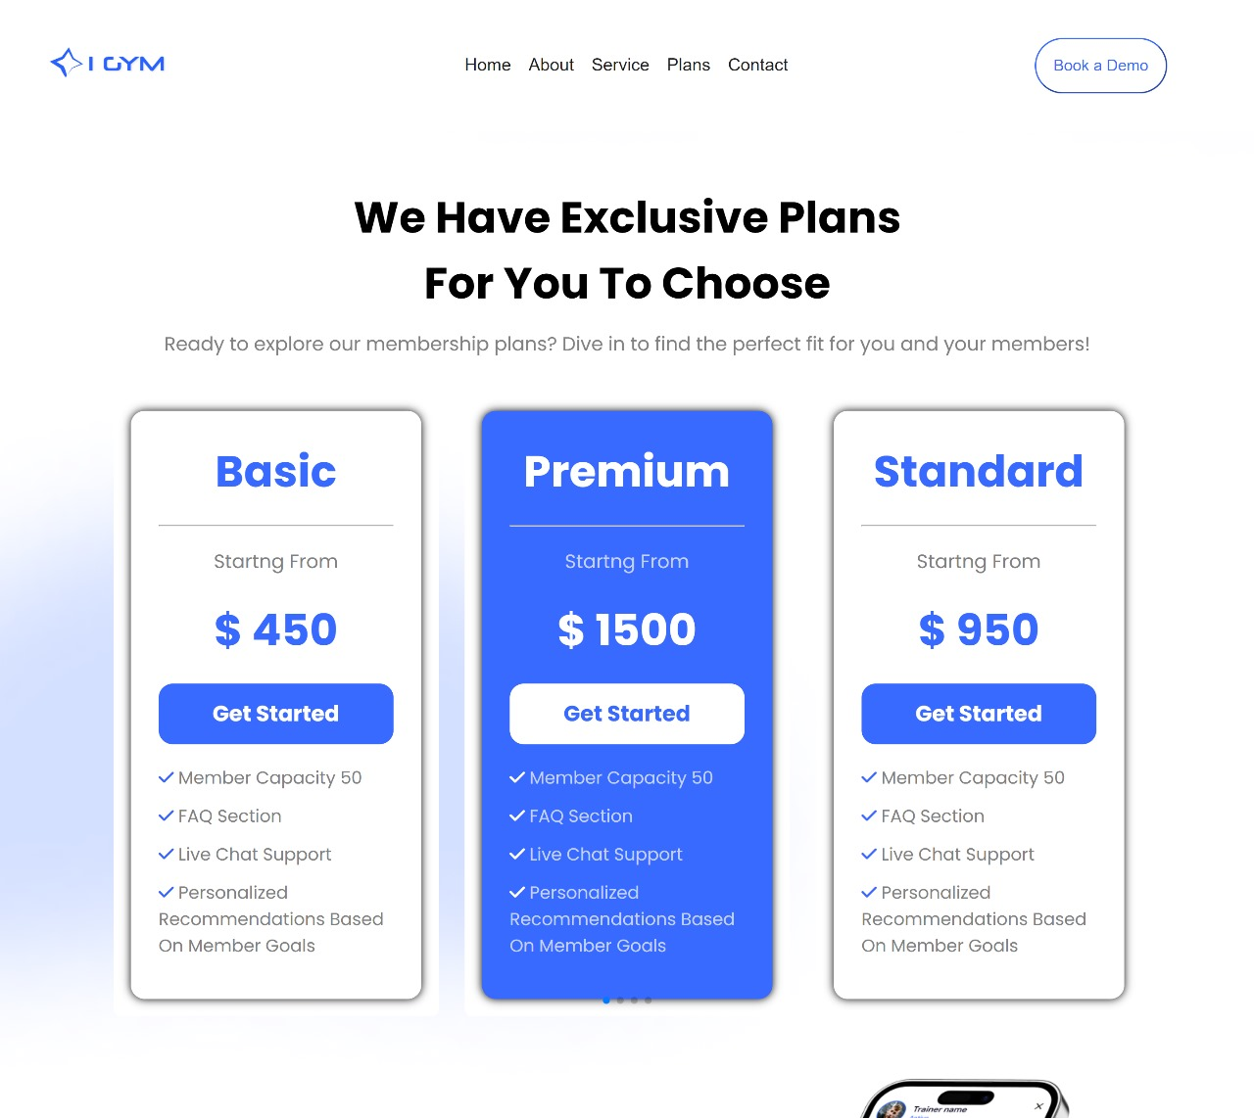
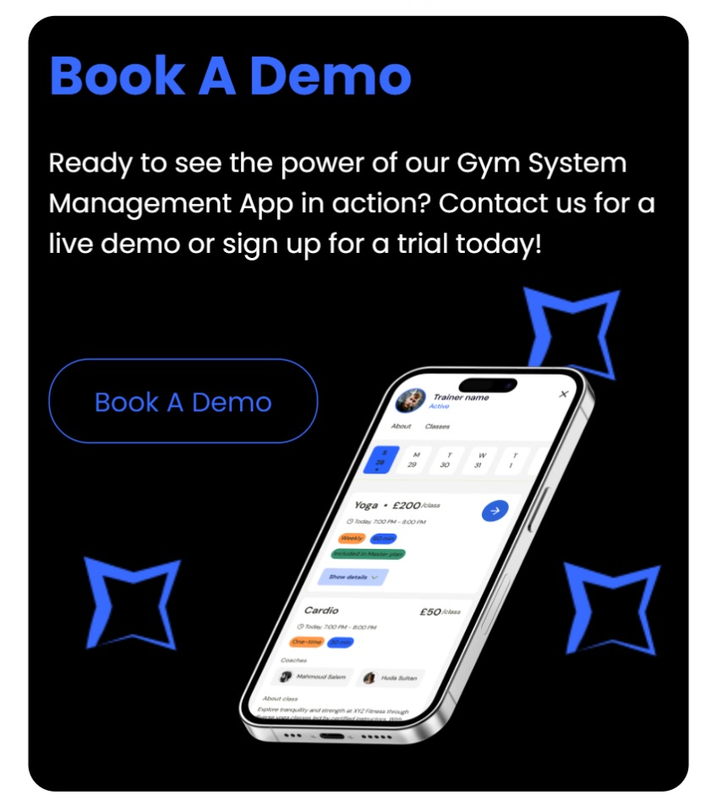
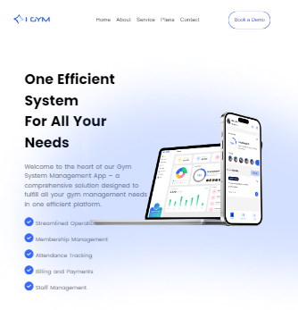
Section 3 Alhussien Ali
This section consists of :-
Some information about the app and a list of its benefits.
4 Subscription plans represented in card slider method.
book a demo section at the end.

Slide 6
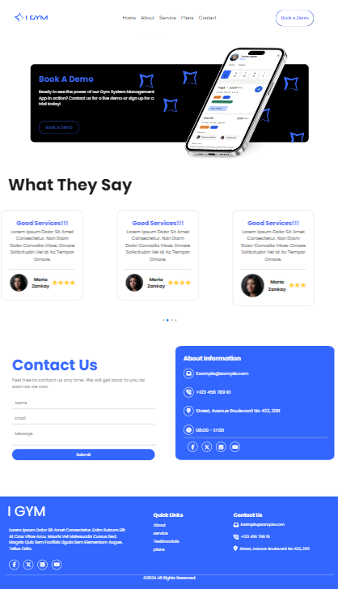
Section 4 Khaled Waleed
This section consists of :-
Customer reviews represented in a card slider method.
Contact us form.
About section includes contact information like e-mail and phone number in addition to some social media links.
Footer at the end of the web page.

Slide 7
Thank you

